Slide 1
COP

Slide 2


Slide 3
Java
What Is JAVA?
Java is a general-purpose, class-based, object-oriented programming language designed for having lesser implementation dependencies. It is a computing platform for application development.
History of Java Programming Language
Here are important landmarks from the history of the Java language:
The Java language was initially called OAK.
Originally, it was developed for handling portable devices and set-top boxes. Oak was a massive failure.
In 1995, Sun changed the name to "Java" and modified the language to take advantage of the burgeoning www (World Wide Web) development business.
Later, in 2009, Oracle Corporation acquired Sun Microsystems and took ownership of three key Sun software assets: Java, MySQL, and Solaris.

Slide 4
History Of JAVA
Java is a programming language and a platform.
Developed by Sun Microsystems (which is now the subsidiary of Oracle) in the year 1995
Invented by Dr.James Gosling and his team in 1994.
Platform: Any hardware or software environment in which a program runs, is known as a platform. Since Java has a runtime environment (JRE) and API, it is called a platform.
Was dismissed as just another OO programming language.
Became popular with the rising popularity of ‘www’.

Slide 5
Java Features
Here are some important Java features:
It is one of the easy-to-use programming languages to learn.
Write code once and run it on almost any computing platform.
Java is platform-independent. Some programs developed in one machine can be executed in another machine.
It is designed for building object-oriented applications.
It is a multithreaded language with automatic memory management.
It is created for the distributed environment of the Internet.
Facilitates distributed computing as its network-centric.

Slide 6
Why JAVA
Features of Java
Object-Oriented
Simple
Robust
Distributed
Secure
Architecture neutral
Portable
Interpreted
Multi threaded

Slide 7
Simple
Java is very easy to learn, and its syntax is simple, clean and easy to understand. According to Sun, Java language is a simple programming language because:
Java syntax is based on C++ (so easier for programmers to learn it after C++).
Java has removed many complicated and rarely-used features, for example, explicit pointers, operator overloading, etc.
There is no need to remove unreferenced objects because there is an Automatic Garbage Collection in Java.
GC

Slide 8
Object-oriented
Java is an object-oriented programming language. Everything in Java is an object. Object-oriented means we organize our software as a combination of different types of objects that incorporates both data and behavior.
Object-oriented programming (OOPs) is a methodology that simplifies software development and maintenance by providing some rules.
Basic concepts of OOPs are:
Object
Class
Inheritance
Polymorphism
Abstraction
Encapsulation

Slide 9
Robust
Java Programs are Reliable
Early checking for potential problems
Dynamic checking to eliminate error-prone situations.
Developer doesn’t have to worry about
Bad Pointers
Memory Allocation Errors
Memory Leakage

Slide 10
Distributed
Java is distributed because it facilitates users to create distributed applications in Java. RMI and EJB are used for creating distributed applications. This feature of Java makes us able to access files by calling the methods from any machine on the internet.

Slide 11
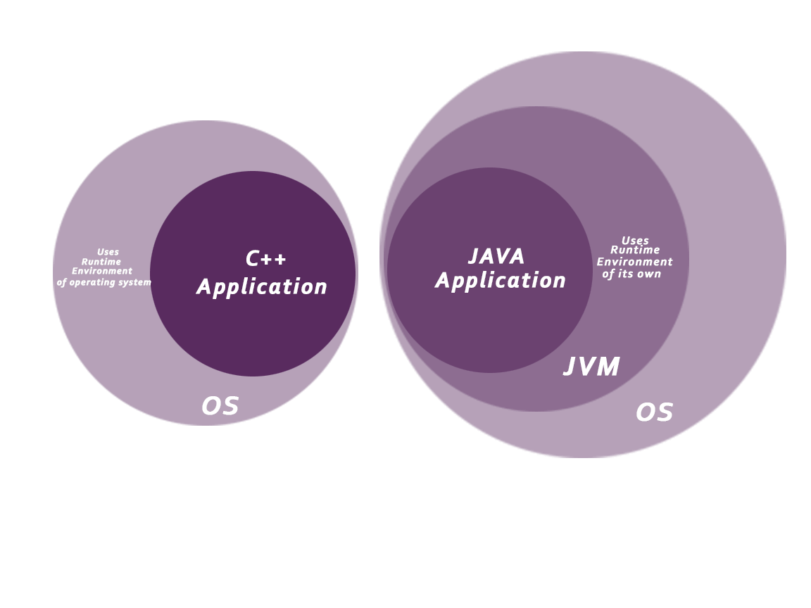
Secure
Java is best known for its security. With Java, we can develop virus-free systems. Java is secured because:
No explicit pointer
Java Programs run inside a virtual machine sandbox

Slide 12
Architecture-neutral
Java is architecture neutral because there are no implementation dependent features, for example, the size of primitive types is fixed.
In C programming, int data type occupies 2 bytes of memory for 32-bit architecture and 4 bytes of memory for 64-bit architecture. However, it occupies 4 bytes of memory for both 32 and 64-bit architectures in Java.

Slide 13
Portable
Java is portable because it facilitates you to carry the Java bytecode to any platform. It doesn't require any implementation.
Behavior of java basic types & arithmetic operators is consistent.
Java program’s behavior is same on every platform –no data type incompatibilities across platforms.
int is always a 32-bit int.
Strings stored in standard Unicode format.
JVM platform Dependent
.java File .class File
JVM
Windows
Linux
JVM
compile
SOURCE
CODE
BYTE CODE
Mac
JVM

Slide 14
Interpreted
ByteCode can be executed on any machine that has java interpreter and java run time system.
Classes are linked only on need basis.
Java is both compiled and interpreted.
MultiThreaded
Thread-safe : Library functions implemented such that it can be executed by multiple concurrent threads.
Built-in support for Threads.

Slide 15
Execution of Java Application
Java Class Libraries
compiler
Byte Code
.java
awt
net
I/O
RMI
…
JDK
*.class file
ClassLoader
ByteCode Verifier
JRE
interpreter
JIT
JVM
Native OS

Slide 16
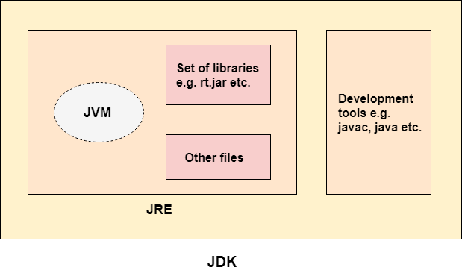
JDK,JVM and JRE

Slide 17
JDK
JDK is an acronym for Java Development Kit. The Java Development Kit (JDK) is a software development environment which is used to develop Java applications and applets . It physically exists. It contains JRE + development tools.
JDK is an implementation of any one of the below given Java Platforms released by Oracle Corporation:
JRE
JRE is an acronym for Java Runtime Environment. It is also written as Java RTE. The Java Runtime Environment is a set of software tools which are used for developing Java applications. It is used to provide the runtime environment. It is the implementation of JVM. It physically exists. It contains a set of libraries + other files that JVM uses at runtime.

Slide 18
JVM
JVM (Java Virtual Machine) is an abstract machine. It is called a virtual machine because it doesn't physically exist. It is a specification that provides a runtime environment in which Java bytecode can be executed. It can also run those programs which are written in other languages and compiled to Java bytecode.
JVMs are available for many hardware and software platforms. JVM, JRE, and JDK are platform dependent because the configuration of each OS is different from each other. However, Java is platform independent. There are three notions of the JVM: specification, implementation, and instance.
The JVM performs the following main tasks:
Loads code
Verifies code
Executes code
Provides runtime environment

Slide 19
JAVA class
The term ‘class’ comes from the word called ‘Classification’.
A class is a template for creation of like objects.
An Object is an instance of class.
Classes are used to map real world entities into data members and member functions.
Encapsulation And Abstractions

Slide 20
Language Basics
Keywords
Variables
Conditional Statements
Loops
Data Types
Operators
Coding Conventions
Notes:
A variable is an item of data named by an identifier.
You must explicitly provide a name and a type for each variable you want to use in your program. The variable's name must be a legal identifier --an unlimited series of Unicode characters that begins with a letter. You use the variable name to refer to the data that the variable contains. The variable's type determines what values it can hold and what operations can be performed on it. To give a variable a type and a name, you write a variable declaration, which generally looks like this:
type name
In addition to the name and type that you explicitly give a variable, a variable has scope. The section of code where the variable's simple name can be used is the variable's scope. The variable's scope is determined implicitly by the location of the variable declaration, that is, where the declaration appears in relation to other code elements.

Slide 21
Java Keywords
abstract | boolean | break | byte | case | catch
char | class | const | continue | default | do
double | else | extends | final | finally | float
for | goto | if | implements | import | instanceof
int | interface | long | native | new | package
private | protected | public | return | short | static
strictfp | super | switch | synchronized | this | throw
throws | transient | try | void | volatile | while
true | false | null

Slide 22
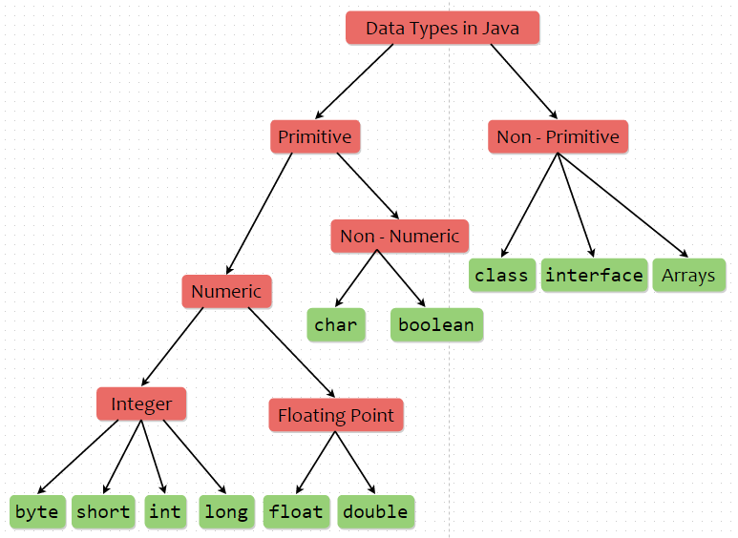

Slide 23
Data Types
Integral Type
byte 8 bits
short 16 bits
int 32 bits
long 64 bits
Textual Type
char 16 bits, UNICODE Character
String
Notes:
When you declare a variable, you explicitly set the variable's name and data type. The Java programming language has two categories of data types: primitive and reference. A variable of primitive type contains a value.
The location of a variable declaration implicitly sets the variable's scope, which determines what section of code may refer to the variable by its simple name. There are four categories of scope: member variable scope, local variable scope, parameter scope, and exception-handler parameter scope.

Slide 24
Data Types
Floating Point Type
float 32 bits
double 64 bits
Boolean Type 1 bit
true
false
Notes:
You can provide an initial value for a variable within its declaration by using the assignment operator (=).
You can declare a variable as final. The value of a final variable cannot change after it's been initialized.

Slide 25
Java Variables
A variable is a container which holds the value while the Java programis executed.
A variable is assigned with a data type.
Variable is a name of memory location. There are three types of variables in java: local, instance and static.
There are two types of data types in Java
: primitive and non-primitive.
Variable
A variable is the name of a reserved area allocated in memory. In other words, it is a name of the memory location. It is a combination of "vary + able" which means its value can be changed.

Slide 26
Variables
A variable is a name given memory location. That memory is associated to a data type and can be assigned a value.
int n=90;
float f1;
char ch;
double d;

Slide 27
Variables conti…
Assigning a value to a variable
Initialization of a variable with a primary value
int n1;
n1 =21 ; // assignment
int i2 = 18; // initialization
char ch = ‘S’; // initialization
double d = 21.8; // initialization
d = n1; // assignment
float f1 = 16.13F;

Slide 28
Naming conventions
class , interfaces , enum names- 1st letter of 1st word must start with upper case & then follow camel case notation.
eg : HelloWorld
data members/methods(functions) -- 1st must start with lower case & then follow camel case notation
eg : performanceIndex,showEmp,dispDetails, getInfo
public double calculateSalary(....) {...}
constants -- all uppercase.
eg : PI

Slide 29
Rules on Identifiers
1. Identifiers must start with a letter,
a currency character ($), or a
connecting character such as the underscore ( _ ),
cannot start with a number!
2. Can't use a Java keyword as an identifier.
3. Are Case sensitive

Slide 30
Access specifiers
private
default(package private) --no access modifier
protected
public
Legal class level access specifiers -
1. default(scope=current package only)
2. public (scope=accessible from any where)

Slide 31
Basic rules
Java compiler doesn't allow accessing of un initialized data members.
A file can have more than one non public class.
There can be only one public class per source code file.
If there is a public class in a file, the name of the file must match the nameof the public class. For example, a class declared as public class Example {....}must be in a source code file named Example.java.
Java compiler doesn't allow accessing of un-initiated vars.
eg : int n;
sop(n);//error

Slide 32
Conversions regarding primitive types
Automatic conversions(widening ) ---Automatic promotions
byte--->short--->int---> long--->float--->double
char ---> int
eg : char ch='a';
long --->float ---is considered automatic type of conversion(since float data type can hold larger range of values than long data type)

Slide 33
Rules ---
Int i=s;
src & dest - must be compatible, typically dest data type must be able to store larger magnitude of values than that of src data type.
1. Any arithmetic operation involving byte,short --- automatically promoted to --int
2. int & long ---> long
3. long & float ---> float
4. byte,short......& float & double----> double

Slide 34
Narrowing conversion --- forced conversion(type-casting)
eg ---
double ---> int
float --> long
double ---> float

Slide 35
Basic Java Syntax Operators Control Statements

Slide 36
Primitive Types and Variables
boolean, char, byte, short, int, long, float, double etc.
These basic (or primitive) types are the only types that are not objects (due to performance issues).
This means that you don’t use the new operator to create a primitive variable.
Declaring primitive variables:
float initVal;
int retVal, index = 2;
double gamma = 1.2, brightness;
boolean valueOk = false;

Slide 37
Declarations
int data= 1.2; // compiler error
boolean flag= 1; // compiler error
double fract= 5 / 4; // no error!
float ratio = 5.8f; // correct
double fracto= 5.0 / 4.0; // correct
1.2f is a float value accurate to 7 decimal places.
1.2 is a double value accurate to 15 decimal places.

Slide 38
Assignment
All Java assignments are right associative
int a = 1, b = 2, c = 5;
a = b = c;
System.out.print(“a= “ + a + “b= “ + b + “c= “ + c);
What is the value of a, b & c
Done right to left: a = (b = c);

Slide 39
Basic Mathematical Operators
* / % + - are the mathematical operators
* / % have a higher precedence than + or –
double myVal = a + b % d – c * d / b;
Is the same as:
double myVal = (a + (b % d)) – ((c * d) / b);

Slide 40
Relational Operators
== Equal (careful)
!= Not equal
>= Greater than or equal
<= Less than or equal
> Greater than
< Less than

Slide 41
Statements & Blocks
A simple statement is a command terminated by a semi-colon:
name = “IACSD”;
A block is a compound statement enclosed in curly brackets:
{
name1 = “IACSD”; name2 = “AKURDI”;
}
Blocks may contain other blocks

Slide 42
Flow of Control
Java executes one statement after the other in the order they are written
Many Java statements are flow control statements:
Conditional Stmt: if, if else, switch
Looping: for, while, do while
Escapes: break, continue, return

Slide 43
if Statement – different syntax options
if (expression)
statement;
A single statement.
if (expression)
{
statements;
}
A block of statements.
if (expression)
statement;
else
statement;
Single statement in the if and a single statement in the else.
if (expression)
statement;
else
{
statements;
}
A single statement in the if and a block
of statements in the else.

Slide 44
Conditional Operator
The operator “ ? : ” is the only operator that takes three operands, each of which is an expression.
The value of the whole expression equals the value of expr2 if expr1 is true, or equals the value of expr3 if expr1 is false.
Syntax:
expr1 ? expr2 : expr3

Slide 45
switch Statement
The nested if can become complicated and unreadable.
The switch statement is an alternative to the nested if.
Syntax: switch(expression) { case constant expr: statement(s); [break;] case constant expr: statement(s); [break;] case constant expr: statement(s); [break;] default : statement(s); [break;] }
Usually, but not always, the last statement of a case is break.
default case is optional.
Notes:
altered

Slide 46
Loops
Loops break the serial execution of the program.
A group of statements is executed a number of times.
There are three kinds of loops :
while
for
do … while
Notes:
altered

Slide 47
While – Loop
Syntax: while (expression) or while (expression) Statement; {Statements;}
The loop continues to iterate as long as the value of expression is true (expression differs from zero).
Expression is evaluated each time before the loop body is executed.
The braces { } are used to group declarations and statements together into a compound statement or block, so they are syntactically equivalent to a single statement.

Slide 48
for - Loop
Syntax:
or
Is equivalent to:
for (expr1 ; expr2 ; expr3) statement;
for (expr1 ; expr2 ; expr3) { statements; }
expr1;
while (expr2)
{
{statements;}
expr3;
}

Slide 49
do while Loop
Syntax:
The condition expression for looping is evaluated only after the loop body had executed.
do { Statements; }while (expression);

Slide 50
break Statement
We have seen how to use the break statement within the switch statement.
A break statement causes an exit from the innermost containing while, do, for or switch statement.

Slide 51
continue Statement
In some situations, you might want to skip to the next iteration of a loop without finishing the current iteration.
The continue statement allows you to do that.
When encountered, continue skips over the remaining statements of the loop, but continues to the next iteration of the loop.

Slide 52
What is Scanner ?
A class (java.util.Scanner) that represents text based parser
It can parse text data from any source --Console input,Text file , socket, string;
e.g. Scanner input = new Scanner(System.in);
System.out.print("Enter your name: ");
String name = input.next ();
System.out.println(“Your name is " + name);
input.close();

